Slide 1
Training teachers to implement holistic lessons in the classroom
Shanta Dixit, Nepal
Early Childhood Education and Development Meeting, Karachi
16th-17th September

Slide 2
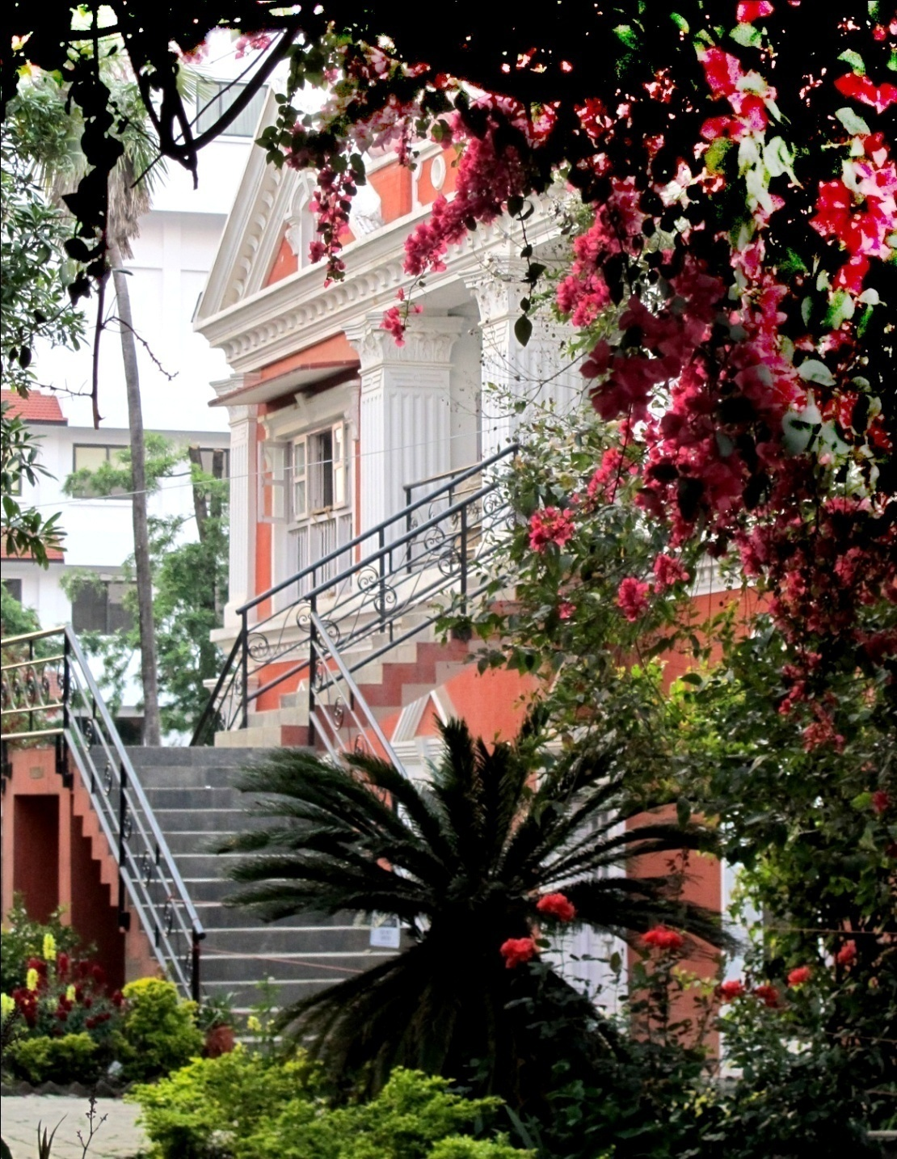
Rato Bangala School established on 1992

Slide 3
Reason, Respect and Responsibility

Slide 4
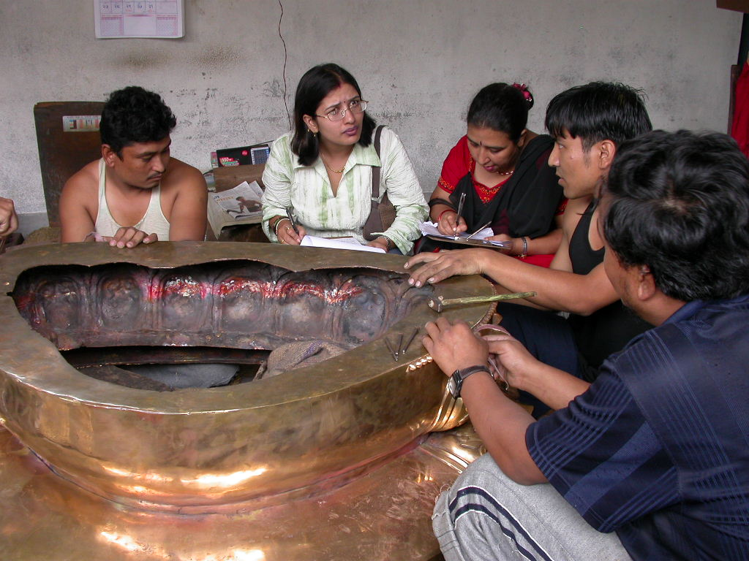
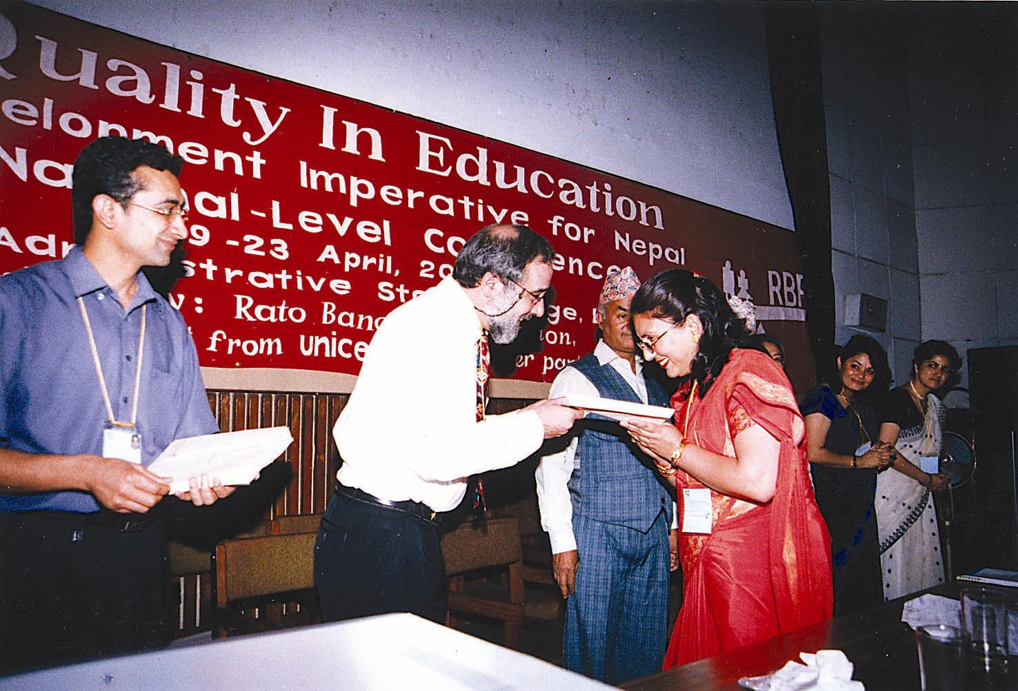
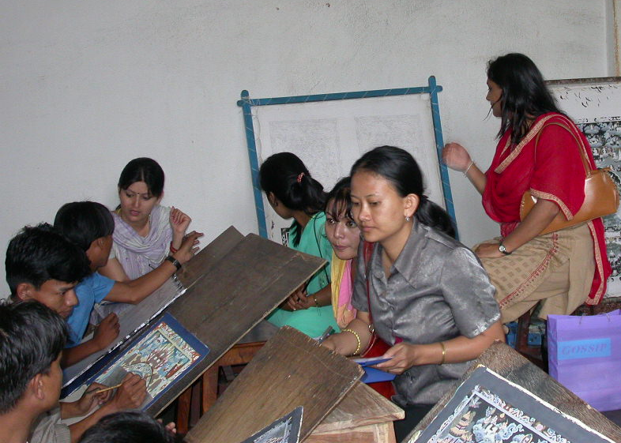
Teacher training is an integral part of the school.

Slide 5
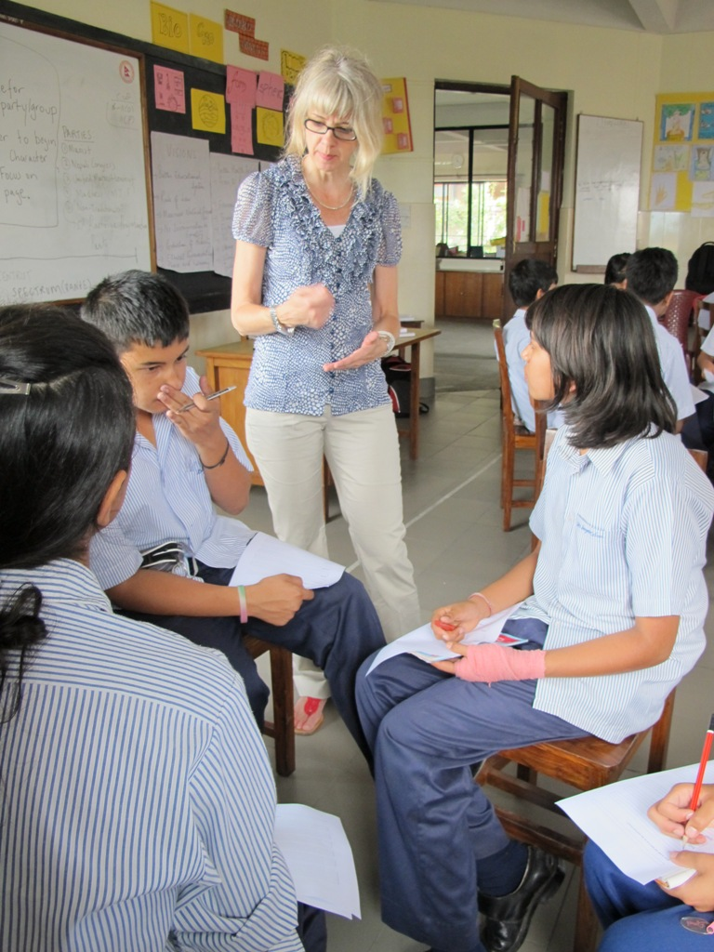
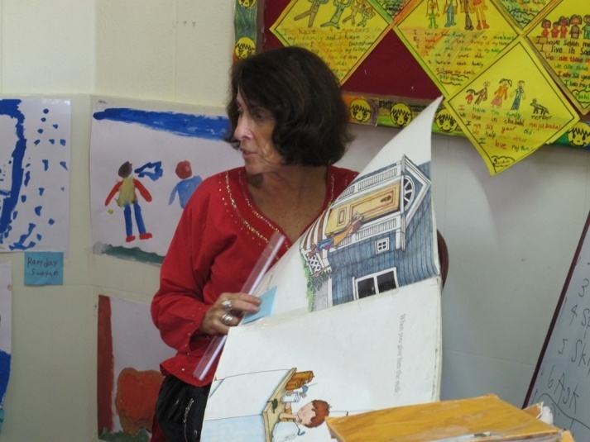
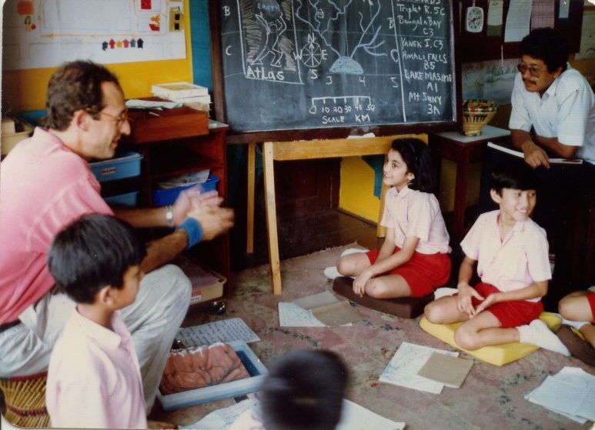
Rato Bangala collaborates with Bank Street College of Education in New York City

Slide 6
Started training teachers from 1997
Rato Bangala Foundation established in 2002

Slide 7
Primary Teacher Training Programme
234 teachers have graduated
All sought after and employed

Slide 8
Eligibility
High school degree for PTTP
Graduate degree for PGDE

Slide 9
Supervised Teaching
This core element of the PTTP consists of four key components:
Placement in cooperating schools
Attendance at weekly “advisement group” meetings
Individual meetings between each trainee and his or her advisor
Long trip outside the valley for community study

Slide 10
Evaluation
Day-to-day work
Classroom participation
Long and short-term assignments.
Continuous assessment 40%
Final exams for 60%.

Slide 11
From Teacher Training to Classroom Implementation

Slide 12
Bakery Study Social Studies
Rato Bangala School Grade I
Curriculum Designed:
Milan Dixit, Principal,
Rato Bangala School

Slide 13
Learning
Sensory- hands on feeling and manipulating the dough through the senses.
Fine motor skills- strengthening little muscles through mixing, manipulating and molding the dough.
Eye-hand coordination- watching and doing and coordinating these actions.
Language development – cooking is a social activity requiring speaking and listening and the development of vocabulary. Reading and writing skills are developed as students read the recipe and instructions purposefully and write their varied experiences. They develop listening, reading and writing skills as well.
Numeracy- predicting and measuring quantities. Counting, grouping, pricing and calculating
Science – observing change of material
Self-esteem- a sense of pride and achievement in seeing concrete result: making and eating the baked items.
Expressing and Reporting – students express what they enjoyed, and write about it
Organizing skills
Group work

Slide 14
Curriculum Sequence (22 lessons)
Lesson 1 : Pre-Trip to the Bakery
Lesson 11 : Baking Oatmeal Cookies
Lesson 18 : Jobs for the Bakery

Slide 15
Lesson: 1 Topic: Pre-trip lesson on Bakery
Materials required: News print paper, pencil, Board marker
Learning objectives: To know about the activities that happen at the bakery.
Meeting Message: Tomorrow we are going on a trip to Dhokaima Bakery. Have you visited a bakery before? Let us think about the different things that you will find at the Bakery and what more you would like to find out.

Slide 16
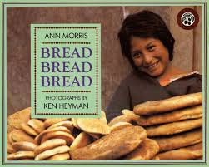
Read to the students
Bread Bread Bread by Ann Morris

Slide 17
Lesson: 11 Topic: Baking Oatmeal Cookies
Materials required
Oatmeal, flour, butter, sugar, baking powder, oven, trays, measuring cups and spoons, bowls and aprons
Learning objective
Children learn to bake oatmeal cookies. They also learn measurement, fractions, changes of materials when mixed, baked and cooked.

Slide 18
Meeting Message:
The shopping groups have bought the ingredients. Today we are going to bake oatmeal cookies. We are sure you are very excited. We are too! Let us talk about how we will work well and have fun as well. We have some parents helping us today. (Parent volunteers introduced. )

Slide 19
Summary activity
Oat Meal Cookies
Ingredients:
1 cup sugar
1 cup butter
2 cups oat
1 cup flour
1 teaspoon baking powder

Slide 20
Lesson: 18 Topic: Jobs
Materials Required
News print papers, markers, lined papers, pencils
Learning Objective/Goals
When we divide jobs among ourselves it is easy to do things.
Meeting Message
We have been learning how to bake many things. Now it is time to plan on how to set up our own Bakery. Shall we invite people to our bakery? Let us think about the different jobs we have to do to run our Bakery.

Slide 21
Sequential outline of Classroom Activities
Children sit on the carpet
Different jobs to be done for the bakery is discussed.
List number of students according to the need
Chair arrangers
Table arrangers
Ushers
Salespersons
Waiters
Clean up crew
Food servers
Customers

Slide 22
Summary activity
Write what is your job and what will you do.
(Teachers have to be mindful of adult supervisors for the different categories as well.)

Slide 23
The Bakery Study as Students Experienced it

Slide 24
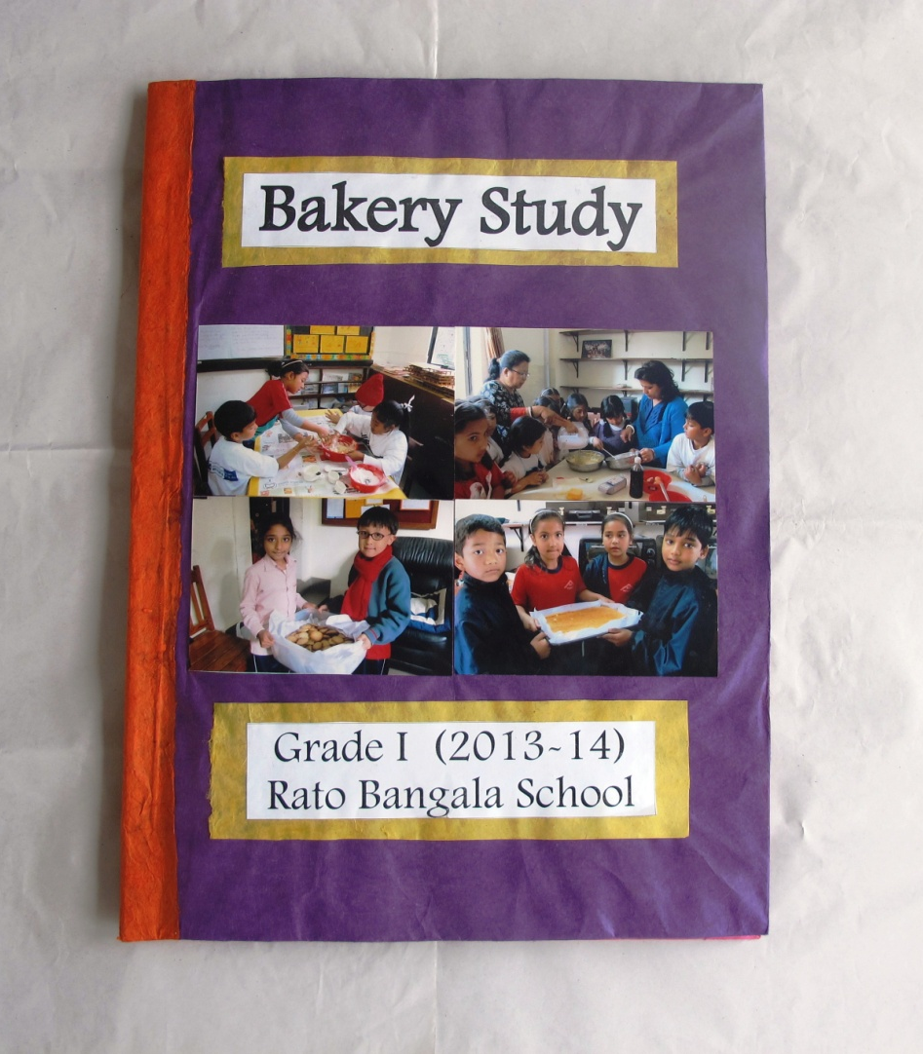
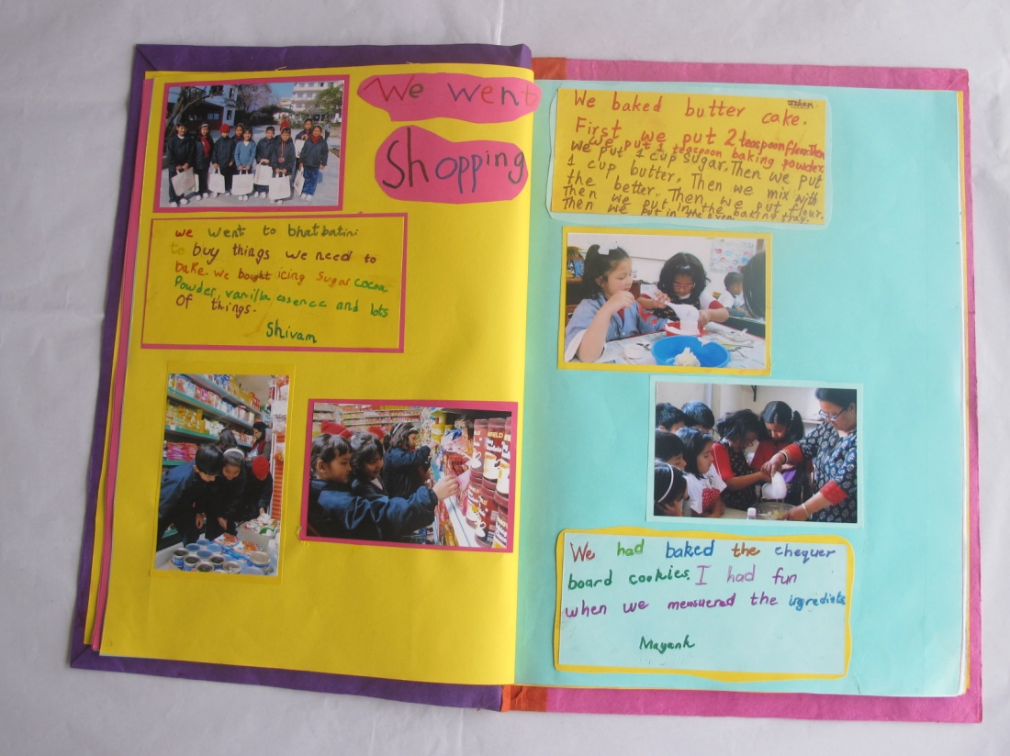
Bakery study

Slide 25
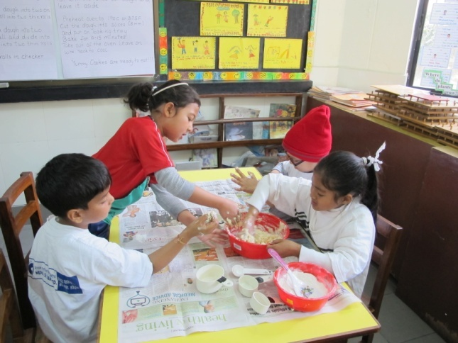
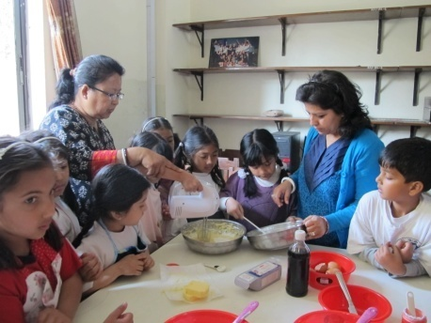
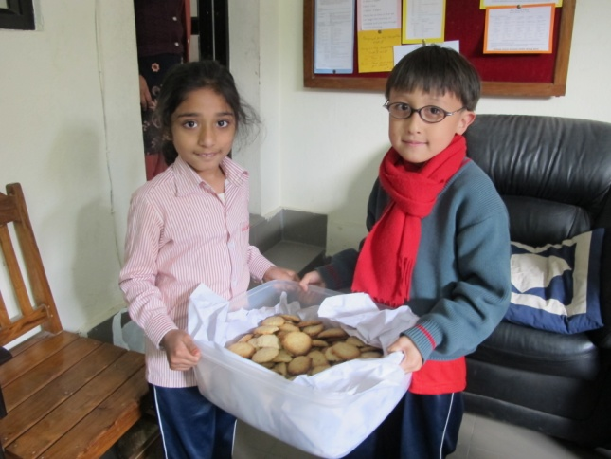
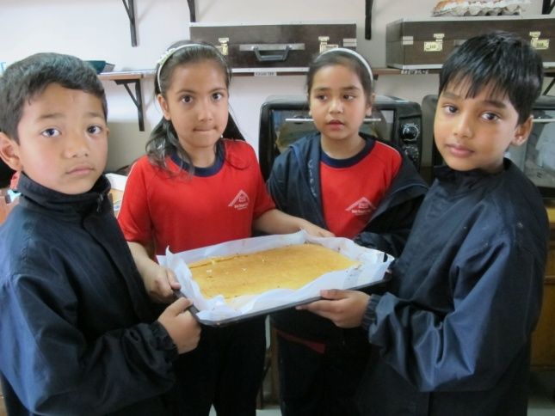
Bakey Study
Grade 1(2013-14)
Rato Bangala School

Slide 26
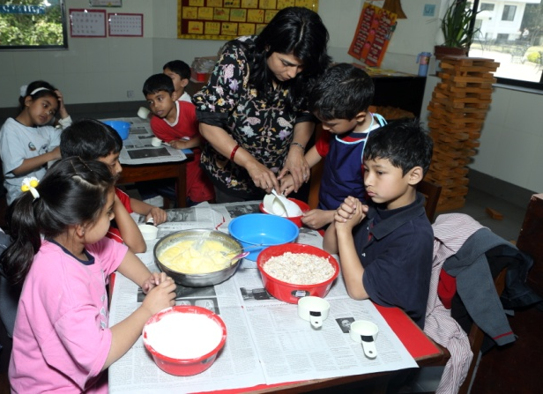
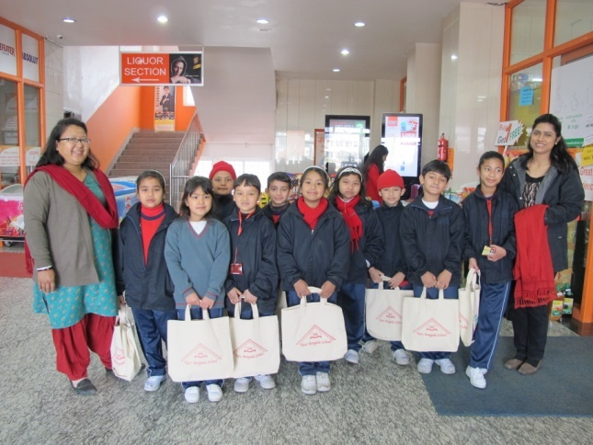
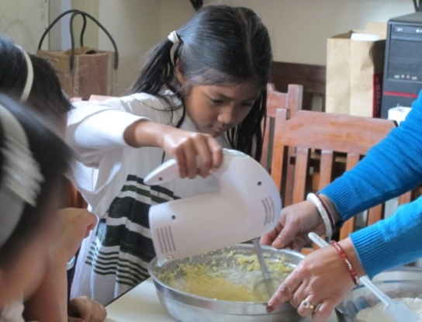
Bakery study – Grade 1
If we mix all the ingredients it will be dough and if we bake it, we can not change the cake back to dough.

Slide 27
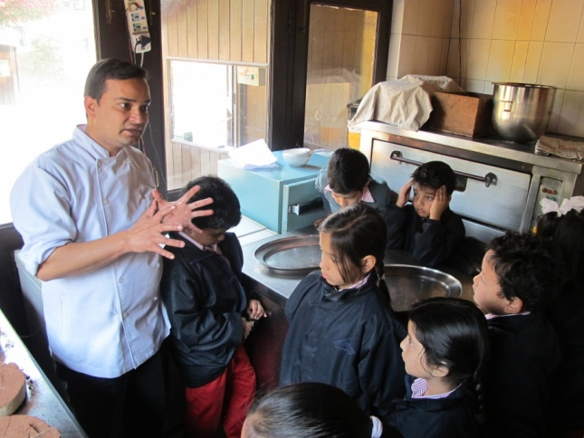
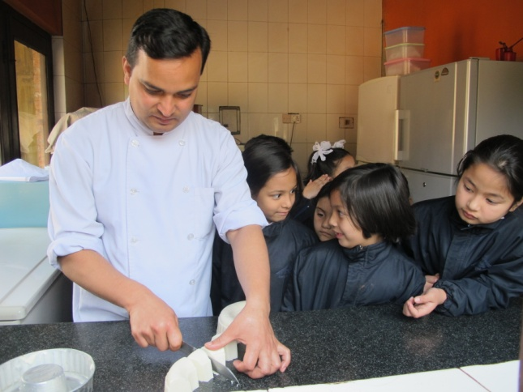
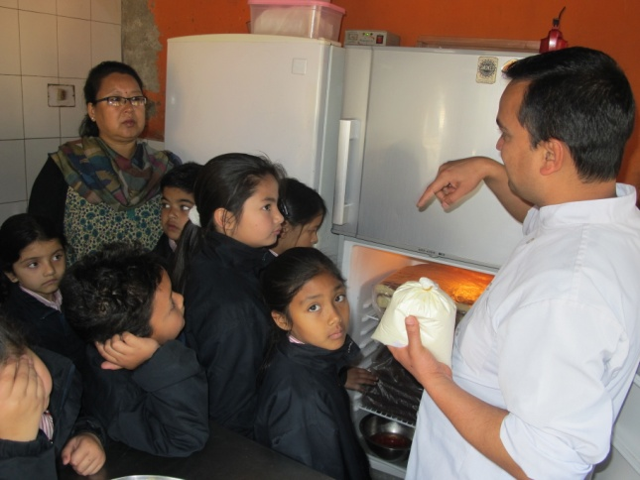
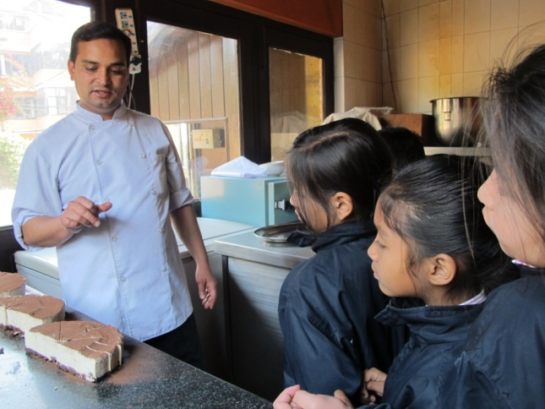

Slide 28
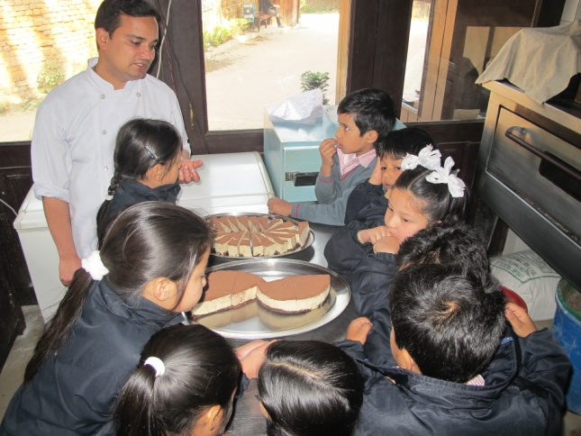
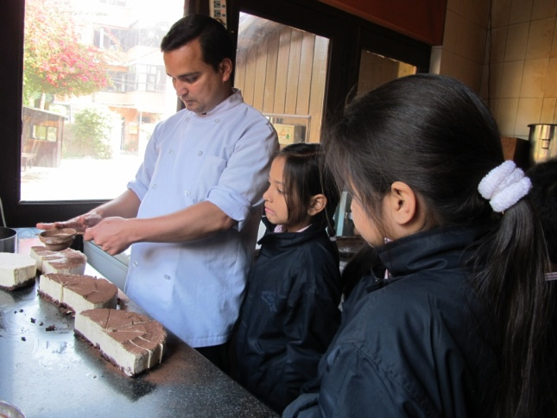
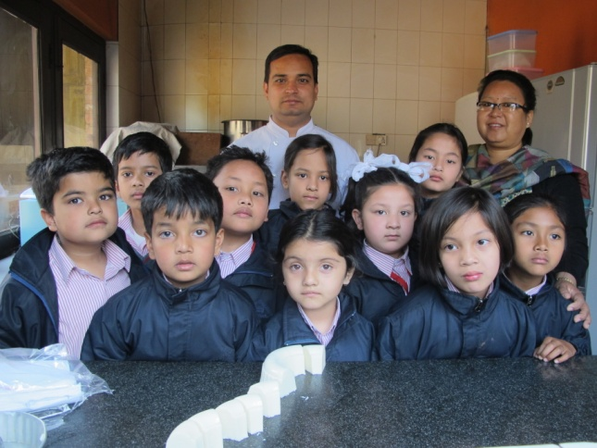
When we visited Dhokaima café bakery , the cook was decorating the cake. I like the way he decorated the cake.
We went to the Bakery
I went to Dhokaima café and I saw a baker baking a cake.

Slide 29
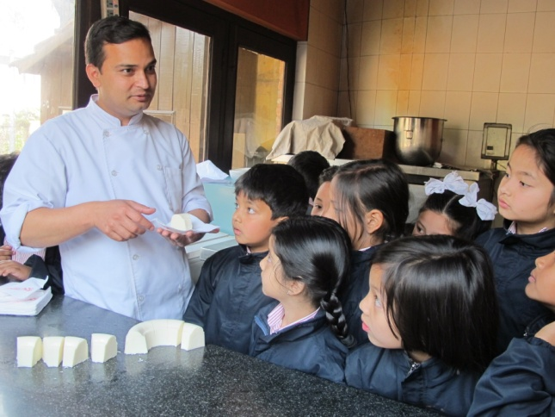
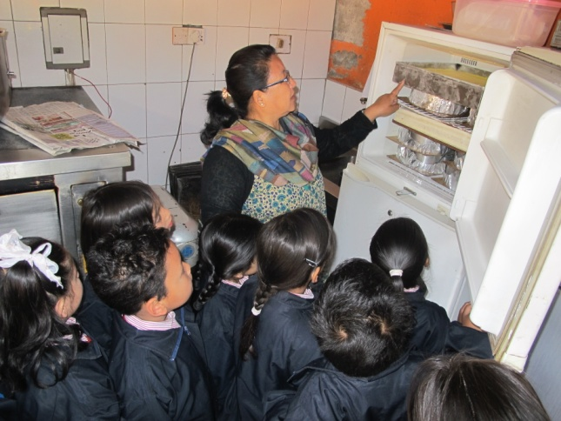
We visited Dhokaima café bakery and the baker was baking cake .I enjoyed him making the cream for decorating the cake.
I enjoy the cake the cook gave us when we visit Dhokaima Café.

Slide 30
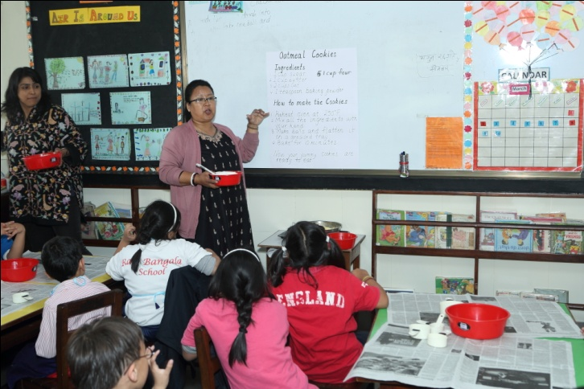
Recipes for our Bakery
Oatmeal Cookies:
Ingredients:
1 cup sugar
1 cup butter
2 cup oat
1 teaspoon baking powder
How to make cookies
Preheat oven at 250 F.
Mix all the ingredient with your hand
Make balls and flatten it on a greased tray
Bake for minutes
Now your yummy cookies are ready to eat
In my recipe book I wrote about butter cake, marble cake, strawberry milk shake, checker board cookies, oatmeal cookies
We baked oatmeal cookies

Slide 31
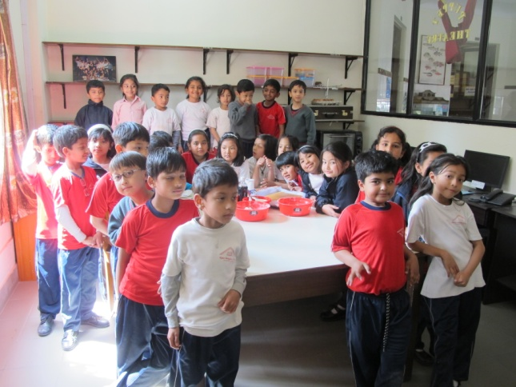
Strawberry milkshake
Ingredients
2 cup milk
4 strawberries
3 table spoon sugar
4 ice cubes (optional)
How to make the milkshake
Pour all the ingredients in the blender
Mix it in the blender for 30 seconds
Pour it in your glass
A tasty refreshing during is ready to drink

Slide 32
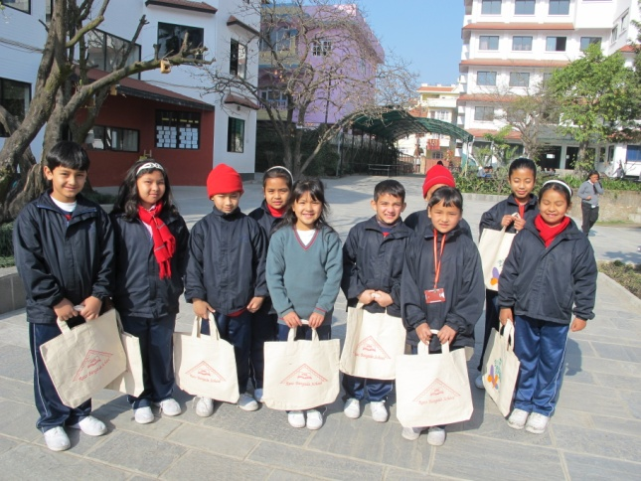
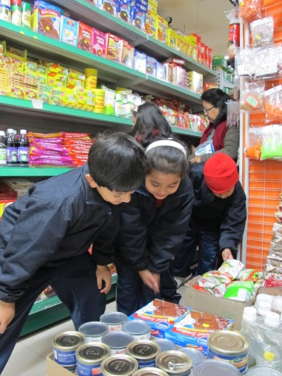
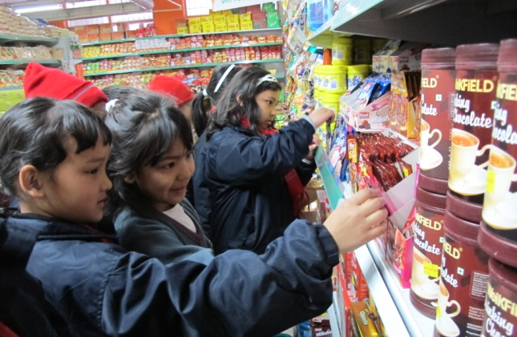
We went shopping
We went to Bhatbhateni to buy thing we need to bake. We bought icing sugar , cocoa powder, vanilla essence and lots of things

Slide 33
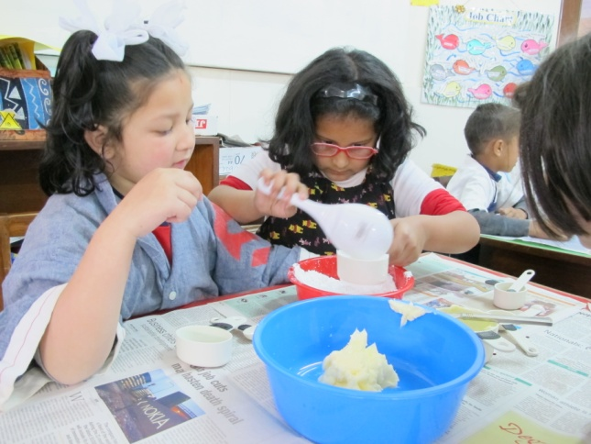
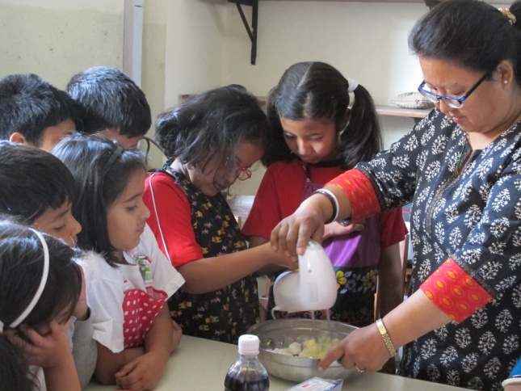
We baked butter cake.
First we put 2 teaspoon flour. Then we put 1 teaspoon baking powder
We put 1 cup sugar. Then we put the 1 cup butter. Then we mix with the butter. Then we put flour. Then we put it in a baking tray
Then we put in the oven.
We had baked a checker board cookies. I had fun when we measures the ingredients.

Slide 34
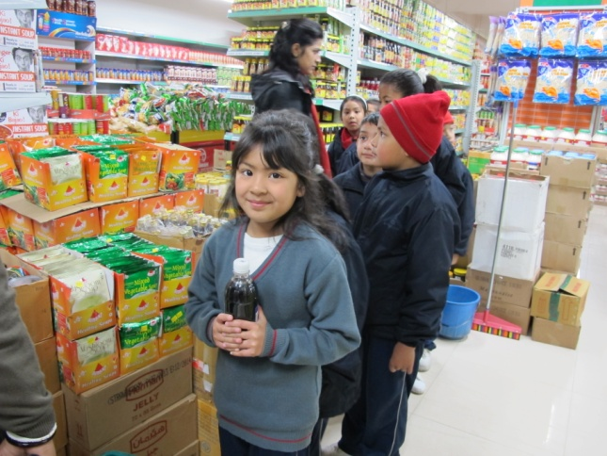
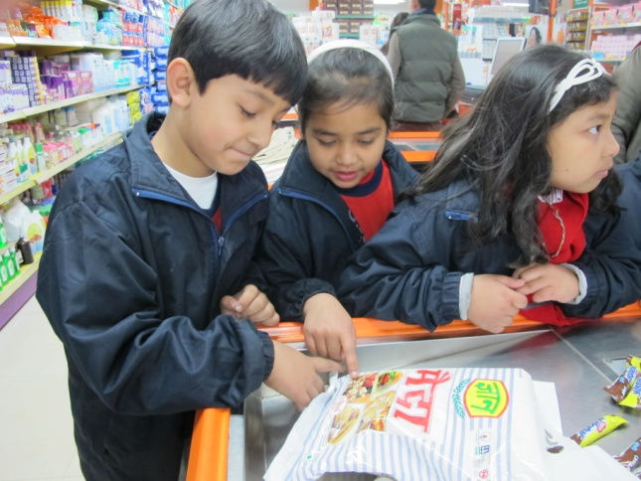
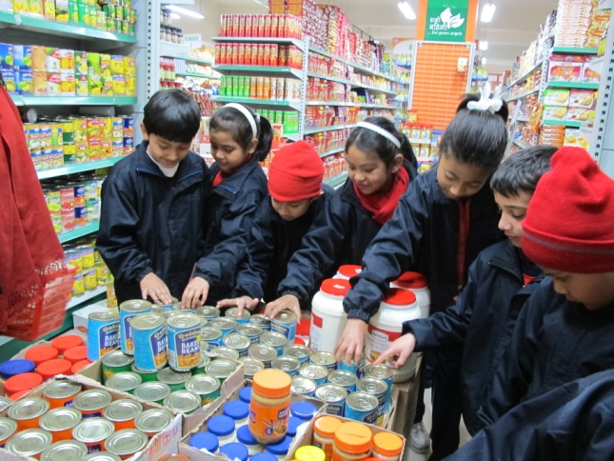
My best time was when we went for shopping in Bhatbhateni and buy all the things we needed for baking.

Slide 35
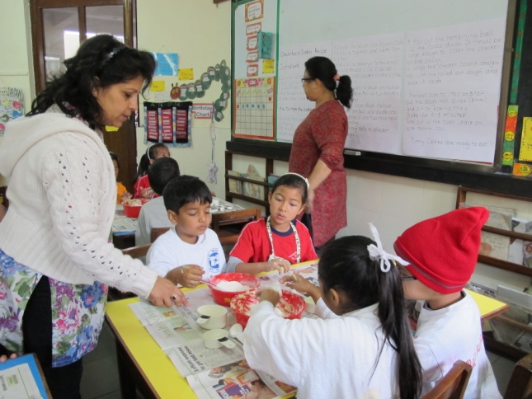
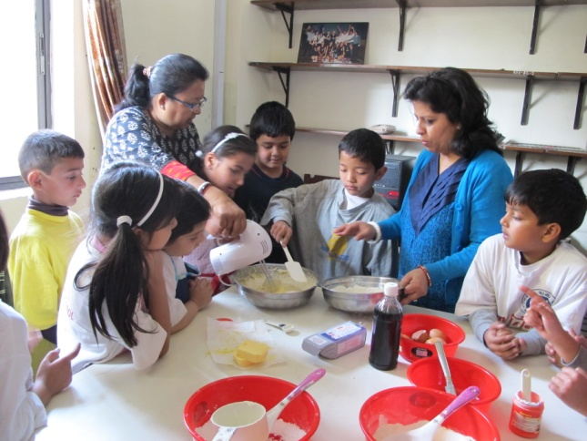
We mix butter, flour, and sugar and it became a dough. Now we cannot change it again into butter, flour and sugar.
We made oatmeal cookies. My best part was mixing flour, sugar, butter and baking powder while baking oatmeal cookies.

Slide 36
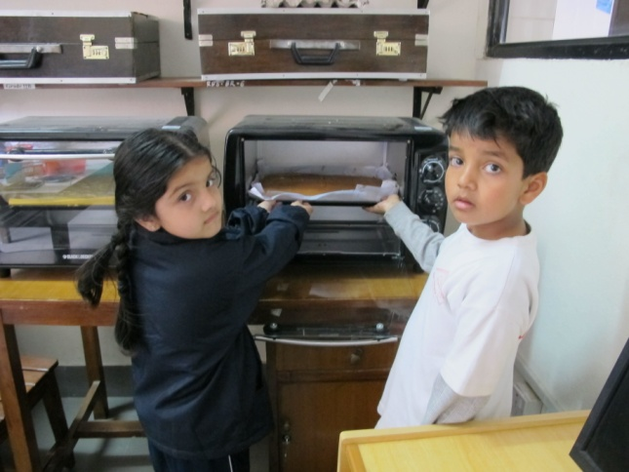
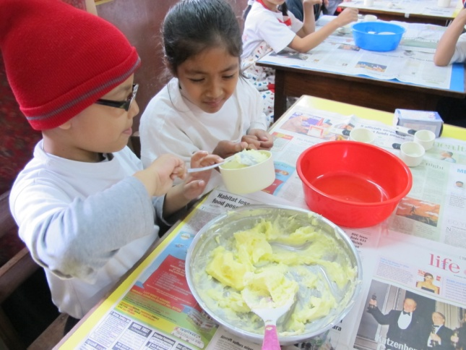
We baked butter cake
To make butter cake. We need flour, sugar, vanilla essence, butter, eggs, baking powder.

Slide 37
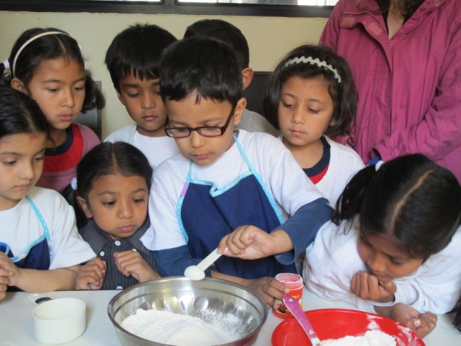
We mixed four eggs butter sugar vanilla essence and flour and it became butter cake. Now it cannot change into eggs, butter, sugar, vanilla essence and flour.
I learned we put butter, flour, icing sugar. when we make cake . After we bake it cannot change back to butter, flour, icing sugar

Slide 38
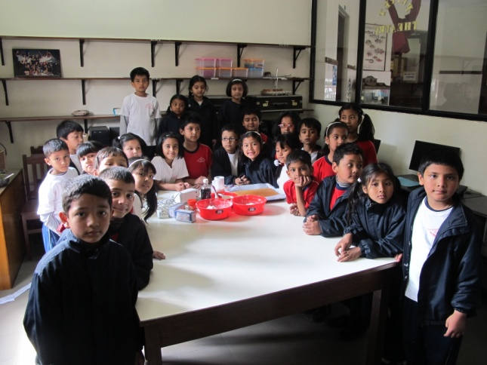
We learned fraction two half makes one whole
I learned measurement when we made cookies and butter cake. It was fun to measure the flour sugar and butter with the cups
Four one fourth cups make a one whole cup. We measured flour with a cup to make cookies.

Slide 39
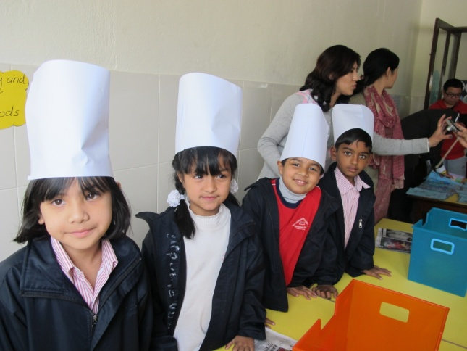
I was seller I sale cookies and cake also other thing .Cookies and cake was tasty I like the bakery .
We had a bakery in class .I was the seller in the bakery .I liked to sell
We the sales men sold the food packets inside there was checker board cookies , oatmeal cookies and butter cake. We four had fun selling the packets
I was the seller I sold lots of cakes and cookies. There were lots of people who bought the cookies

Slide 40
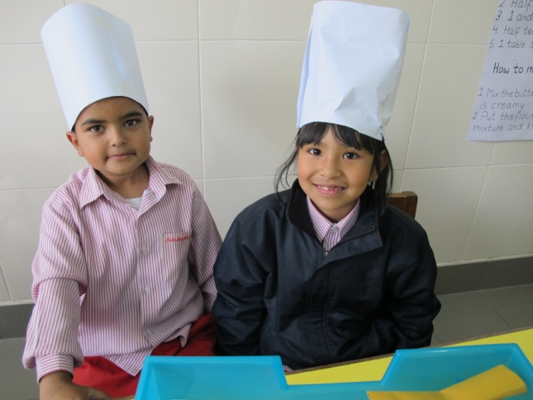
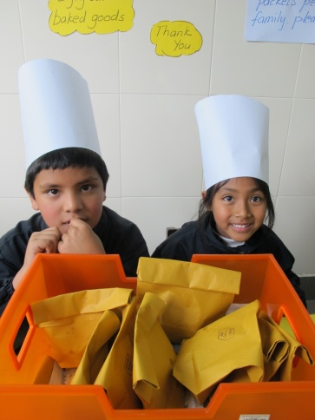
I was salesman my partner was aayam my grand parents came
We had our bakery yesterday .I was the sales man I ate checkerboard cookies butter cake , oatmeal cookies and strawberry milkshake . I had lots of fun
I was the seller in bakery I sold cookies and butter cake my partner was Anushree

Slide 41
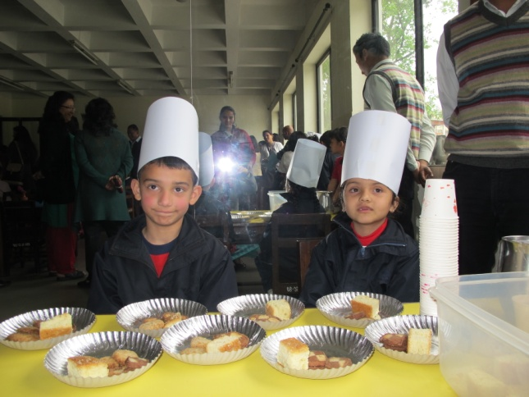
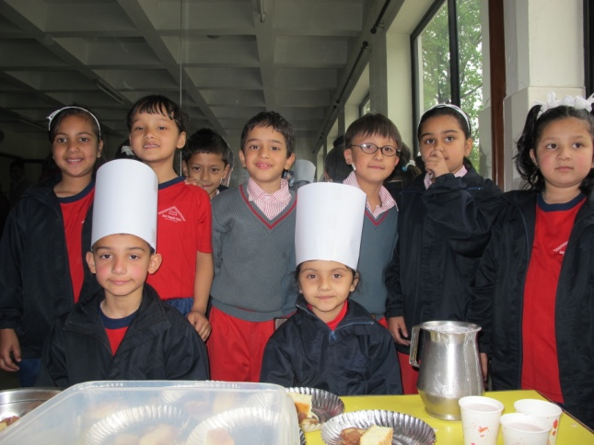
I was a server. We wore we wore white long paper caps. We had lots of fun
I was the server. I served food like cookies and cake. I felt good when I was serving cookies and cake

Slide 42
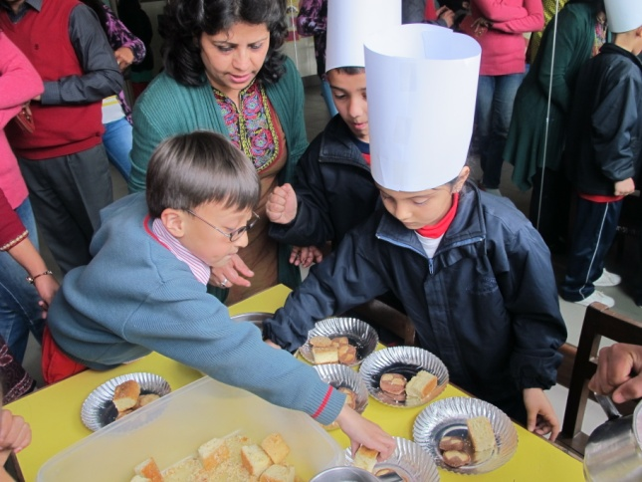
Yesterday was bakery in our school I was a waiter. I also ate cookies and milkshake
I liked the part of when I served people and friends
I was waiter in the bakery
I helped the server
I like the bakery
I was a waiter. I have to serve food. Server gave us food and we served it. We had lots of fun

Slide 43
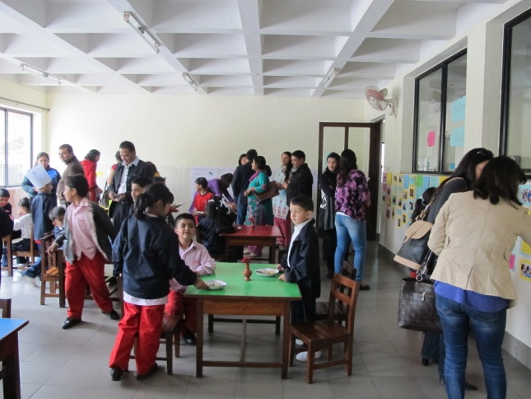
I was the waiter and I had to give cake and cookies to my friends
Yesterday was our bakery and I was a waiter. I gave my friends cookies, cakes, milk shakes
Yesterday was our bakery . I was the waiter . We served the food to our friends. We served cake cookies and milk shake. We had lots of fun
I was the server . I had a wonderful experience serving foods to the customers

Slide 44
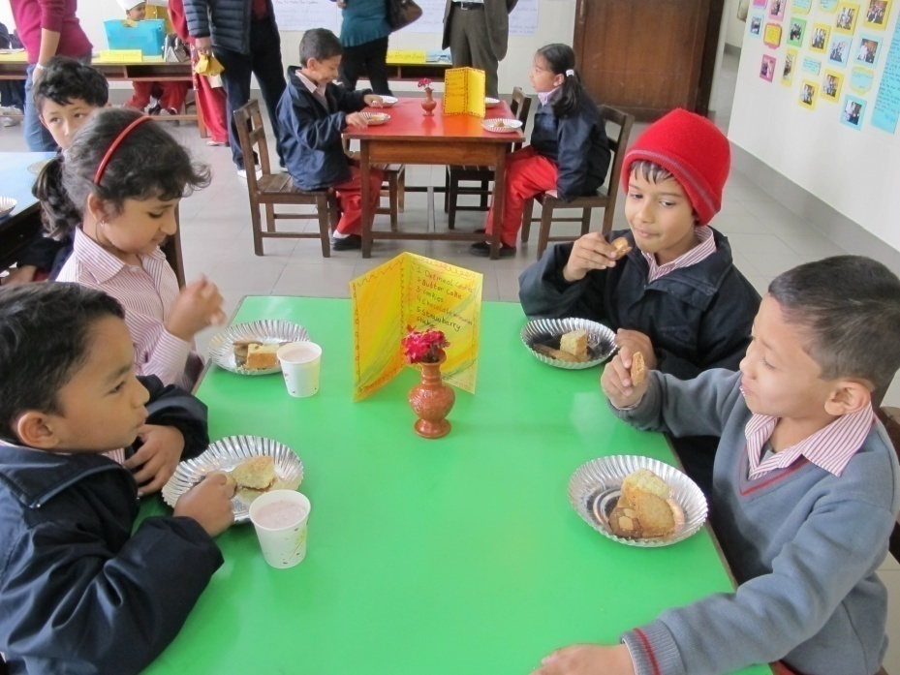
On Our bakery, I was the waiter. I served cookies and cakes. For the drinks, I gave strawberry – milk shakes. We had fun serving cookies, cakes, and strawberry milk shakes.
We had a bakery in our class. I was waiter and I put foods on the table
I also ate oatmeal cookies, battercake and strawberry milk shakes

Slide 45


I was a chair arranger and waiter gave us cookies and milk shakes . I had fun eating cookies and milkshakes
I was the server I was sitting on the chair and after a while lots of parents came they enjoyed a lot and I also enjoyed a lot.

Slide 46


I was a server and I served all the food and threw the paper plates and paper glasses in the dust bin. This was my favorite part
I was the server. I serve cake and cookies in the plate. I even pour milk shakes in the glass.

Slide 47


We had café yesterday. I was the server. I served the food and I ate cookies.
I was chair arranger. I did my job. In 2 o'clock it was my turn to eat cookie.

Slide 48


I was the chair arranger and we took chairs to one big room. I also ate cookies and cakes.
I was a chair arranger. In chair arranger there was also Krishang, Bibhar and Ishan. We have to take the chairs
In our café area day I was the server. My mother came in our café area day. It was fun to serve. Before our bakery day we made checker board cookies oatmeal cookies, marble cakes, butter cakes, and in our bakery day we made strawberry milk shake. I had fun.

